Slide 1

2
0
2
2
MIE1624 Course Project
Group 19
HaoLiu JunyuJiang KeyangZhao TongyuanZhu XinyiYao YijiaGao ZhitingZhang
Notes:
HI everyone. Welcome to Group 19 MIE 1624 Course Project.

Slide 2

1
MIE1624 Course Redesign
CONTENTS
Program Curriculum Design
2
3
Program Visualization
4
Recommender System Design
Notes:
This is our contents.There are 4 parts. Part 1 is MIE1624 Course Redesign. Part2 and 3 are program curriculum design and visualization. Last part is recommender system design

Slide 3
01
MIE1624 course redesign
PART 01
Notes:
Part1:MIE 1624 course redesign.

Slide 4
Resourse
Kaggle Machine Learning & Data Science Survey 2021
Similar courses
Notes:
To redesign the course MIE1624, the Kaggle Machine Learning & Data Science Survey 2021 was used as our resource. In addition, we also referenced similar courses to MIE1624 were found on platforms such as Coursera, WeCouldData and some other universities' websites.

Slide 5

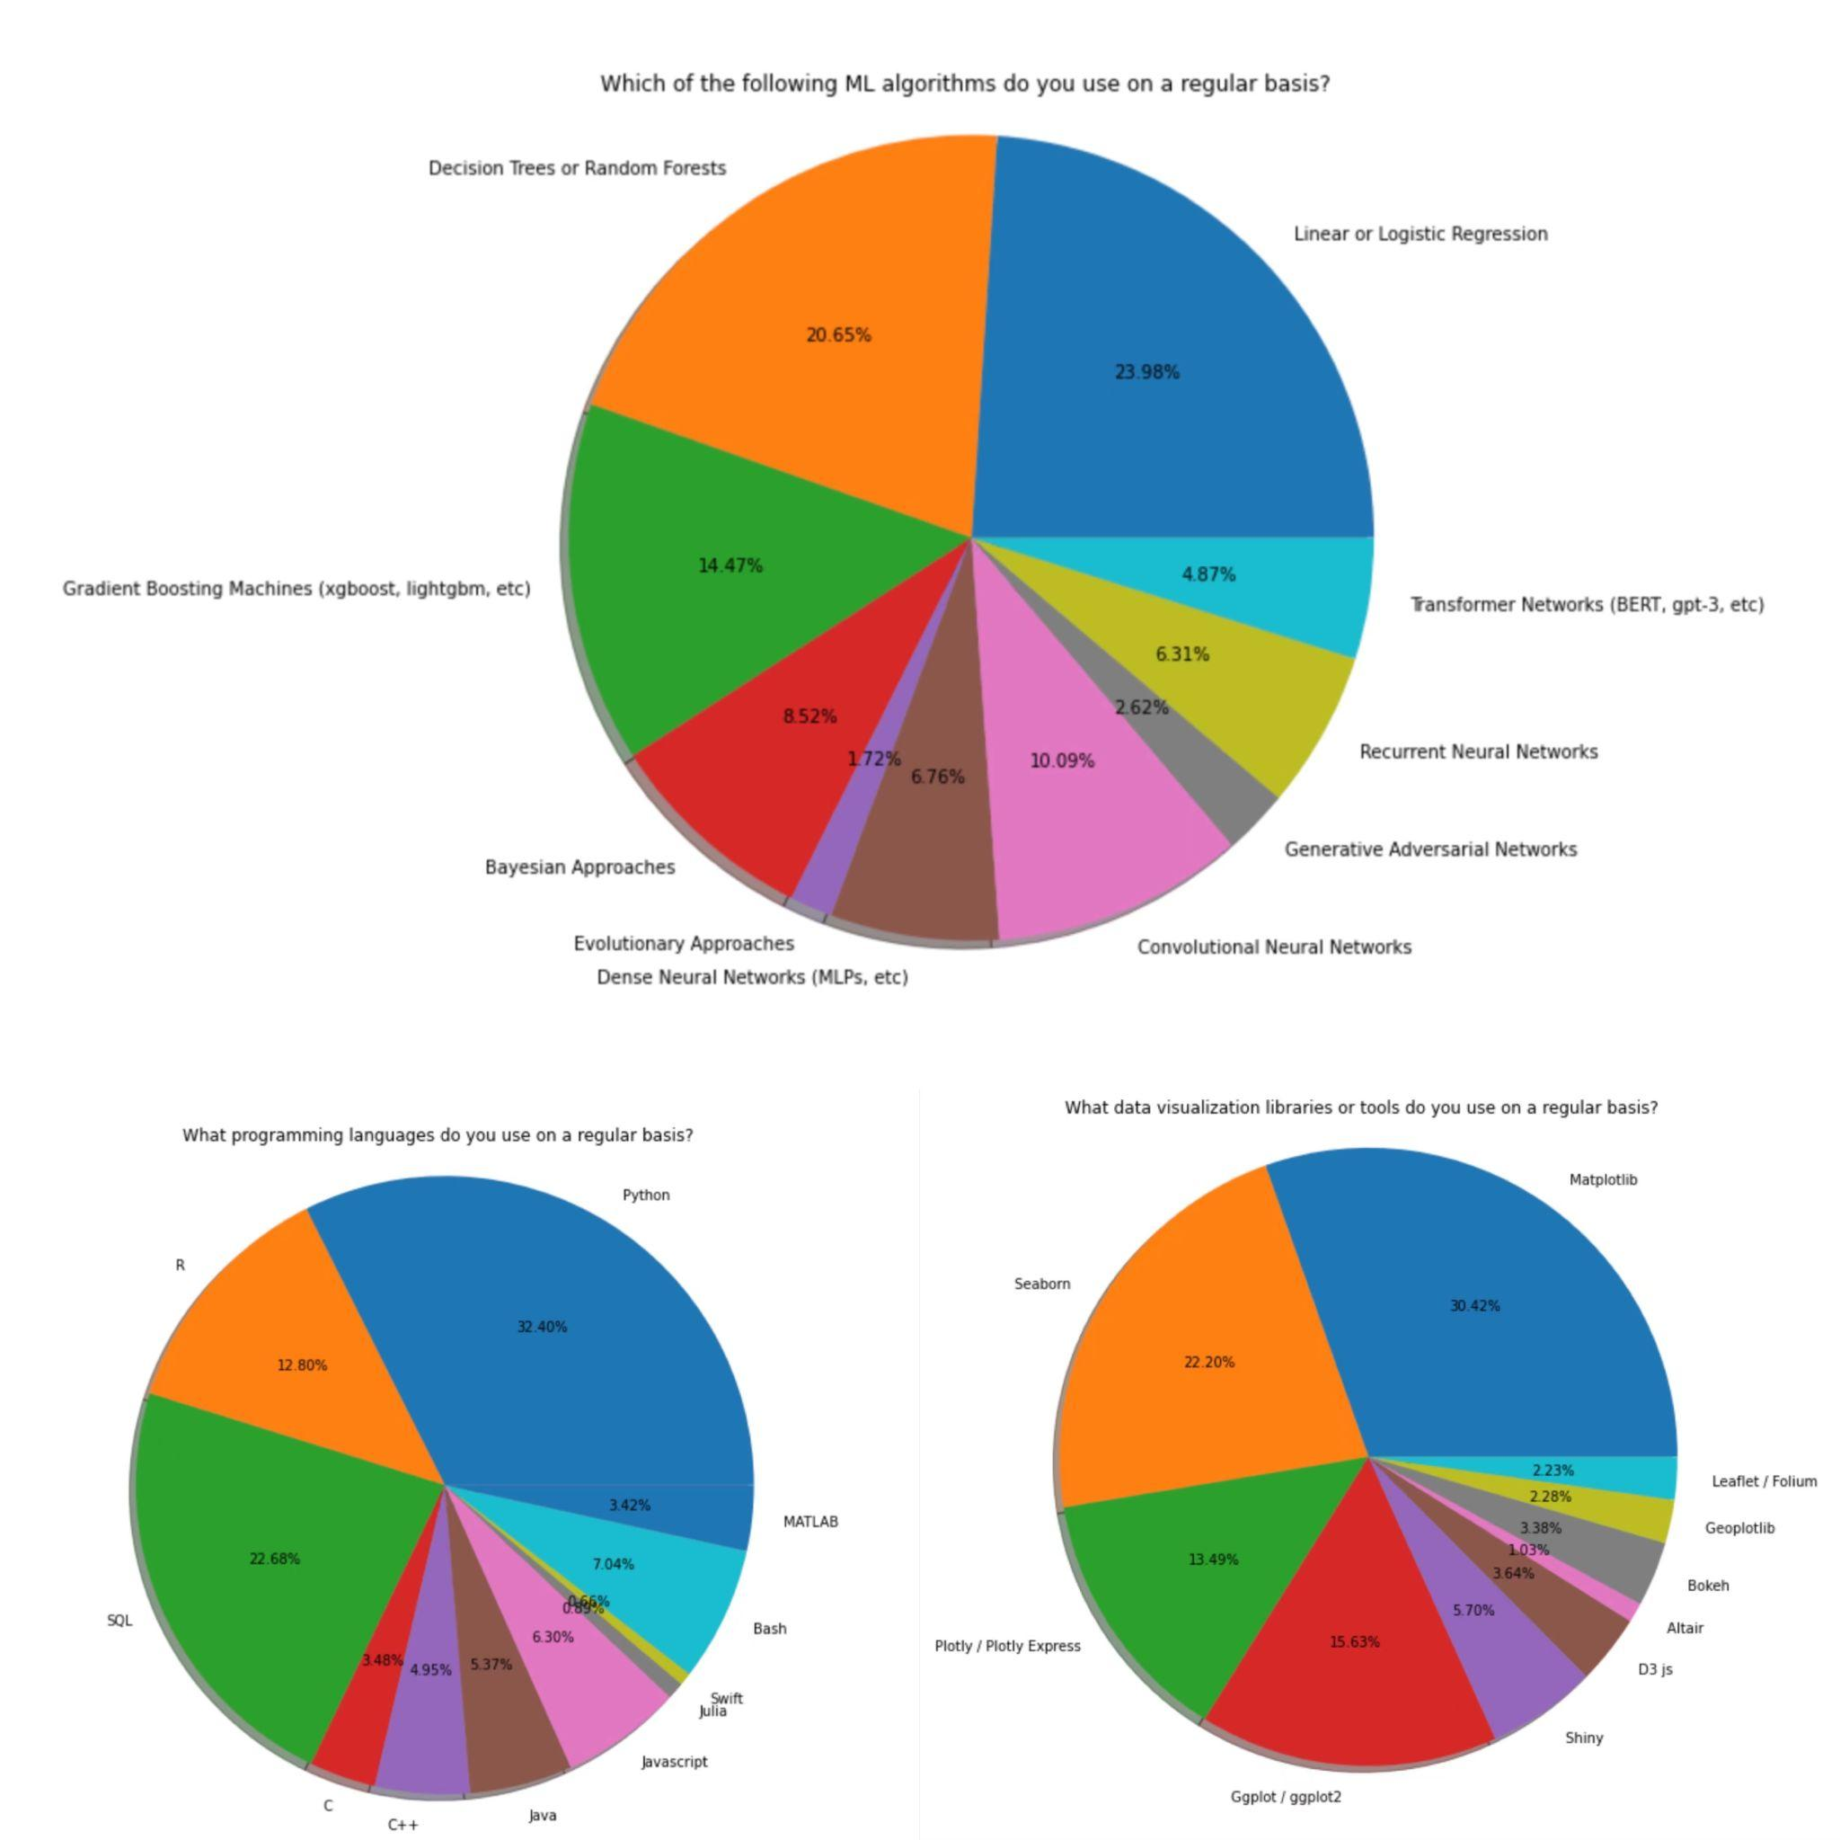
Analysis the survey data
The most popular computer programming languages are Python, SQL and R.
The most frequently used machine learning algorithms are linear or logistic regression, decision trees or random forest and Gradient Boosting Machines
Matplotlib and Seaborn are the two most frequently used visualization libraries
Notes:
This figure shows responses of three questions in the kaggle survey. These responses illustrates that Tthe most popular computer programming languages are Python, SQL and R. The most frequently used machine learning algorithms are linear or logistic regression, decision trees or random forest and Gradient Boosting Machines. And Matplotlib and Seaborn are the two most frequently used visualization libraries.

Slide 6
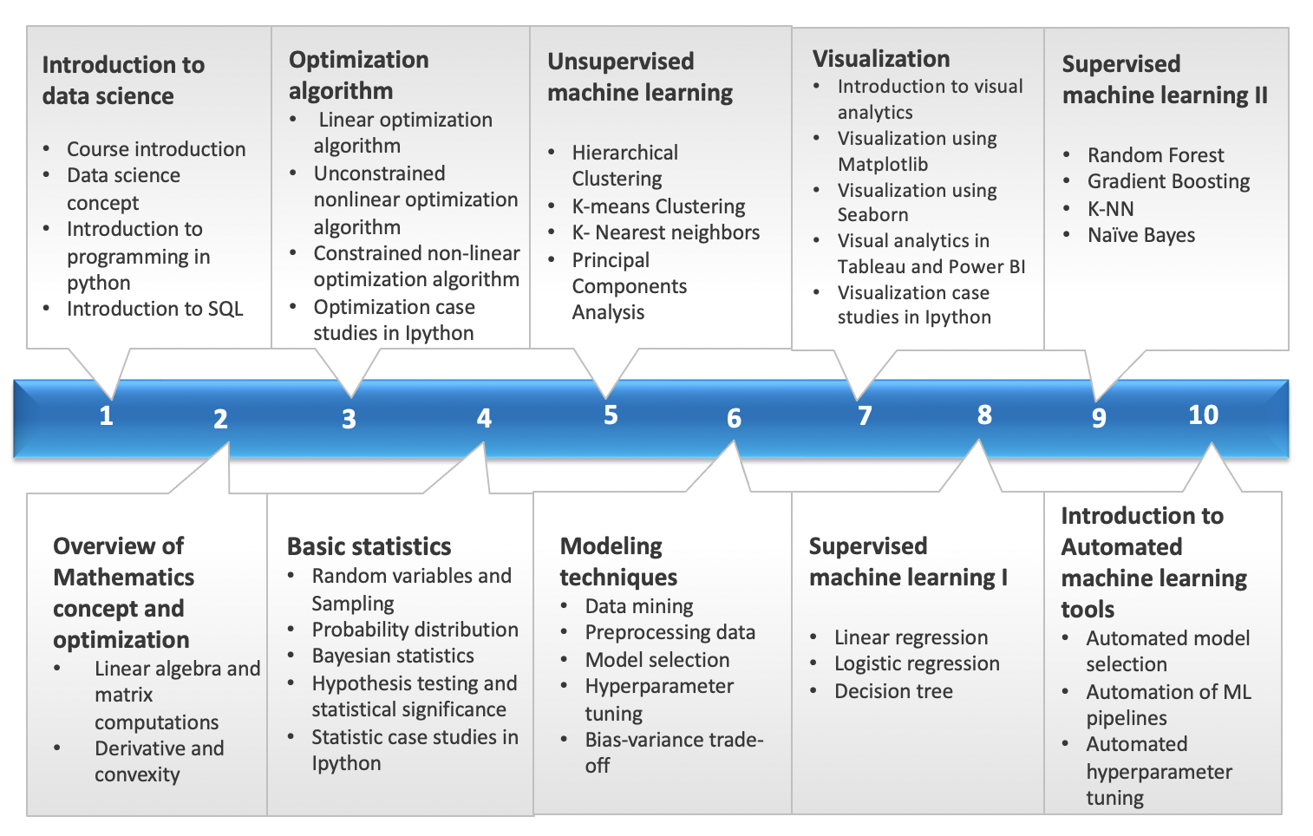
MIE1624 Module
Notes:
Similar to what we have The core language in this course is python and the suggested integrated development environment is Jupyter Notebook. You can see course outline in this graph. We have 10 modules, In the beginning of the course is the introduction to data science which include intro to Python and SQL and some reviews on mathematics and basic statistics Then the course will cover many machine learning algorithms and visualization and modelling techniques. The last part of the course will introduce some automated machine learning tools such as automated model selection and hyperparameter tuning. This course will also include 3 individual assignments and 2 group projects since most of the data relevant jobs will face the situation of working in a group.

Slide 7
Program Curriculum Design
02
PART 02
Notes:
Okay let’s talk about the newly-designed curriculum for UofT: Master of Data Science and AI.

Slide 8
1
Web-scraped data from Indeed
Sources
2
Insights from Part 1
3
Similar programs worldwide
Notes:
To design this curriculum, we referred to three kinds of source: the major one is the web-scraped datasets from indeed.com; also, the Kaggle dataset from Part 1; and finally, some other data- or AI-related programs all around the world.

Slide 9
Identified skills
Coding & Software
Professional
Business-oriented
Python
R
Tableau
…
Data analysis
Database management
Data visualization
…
Communication
Teamwork
Leadership
…
Notes:
With these sources, we were able to identify a list of significant skills that are necessary for our students to work in the field of data science and AI. By inspecting the frequencies of these skills’ appearance in the indeed job descriptions, we determined the importance of each skill. Then, we were able to create our courses and assign them to different specializations.

Slide 10
Program Structure
Time Length
16 months, full-time, 7 credits
Comprehensive Learning
Courses
2 introductory courses, 4 core courses, 6 elective courses
1 co-op term
1 capstone project equals to 2 elective courses
Real-world Experience
Diverse Challenge
Specializations
Data analysis
Data science
Data engineering
Data management
Notes:
Our program has three features: it involves comprehensive learning, real-world experience and diverse challenges. It’s 16-month full-time program. The students are required to achieve 7 credits which must include 2 introductory courses, 4 core courses, 6 elective courses and 1 co-op term that is equivalent to 1 credit. They can also choose to work on a Capstone project which is equivalent to 2 elective courses. Our program is designed to be very career-oriented in order to help students find the job they particularly want, therefore, there are four segmented specializations for them to choose: data analysis, data science, data engineering and data management. We recommend courses to students based on their specializations.

Slide 11
Program
Visualization
03
PART 03
Notes:
Now, we move to Part 3, where we visualize not only the big structure of our program but also the details of it for anyone who is interested in our program.

Slide 12
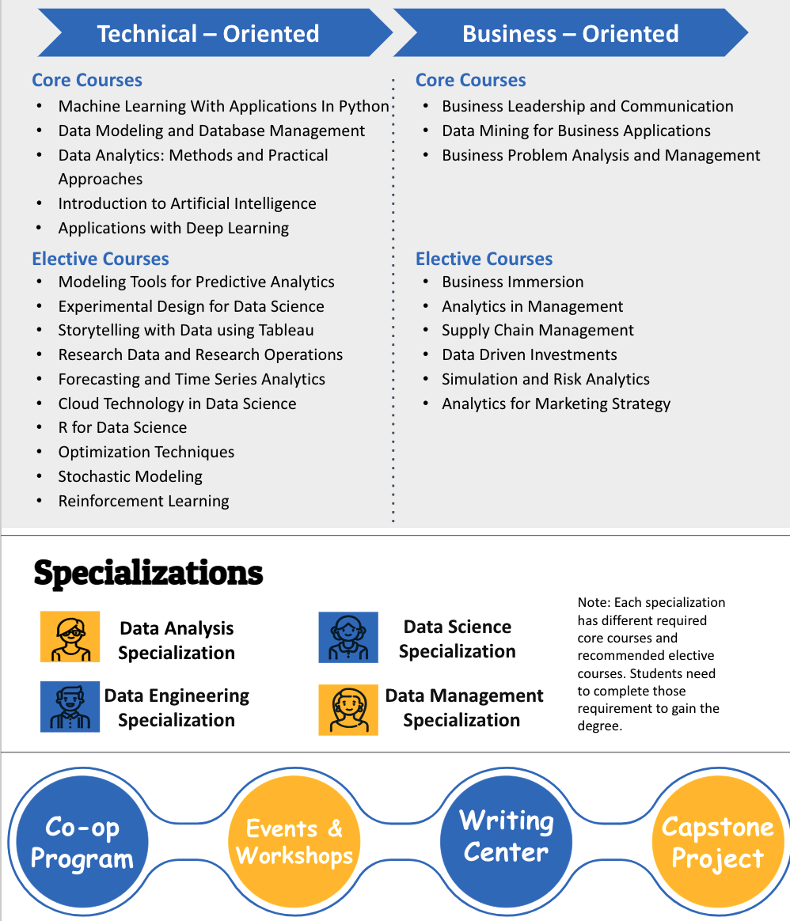
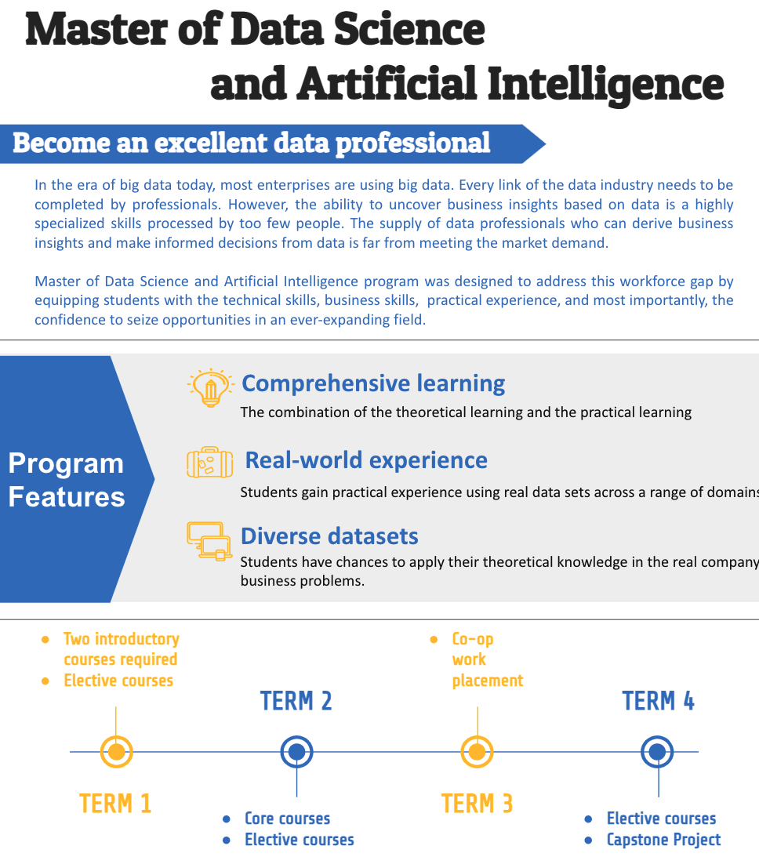
Notes:
This is the poster of the whole program structure for potential applicants. It displays all information discussed in Part 2 and give our future students a clear view of our program.

Slide 13
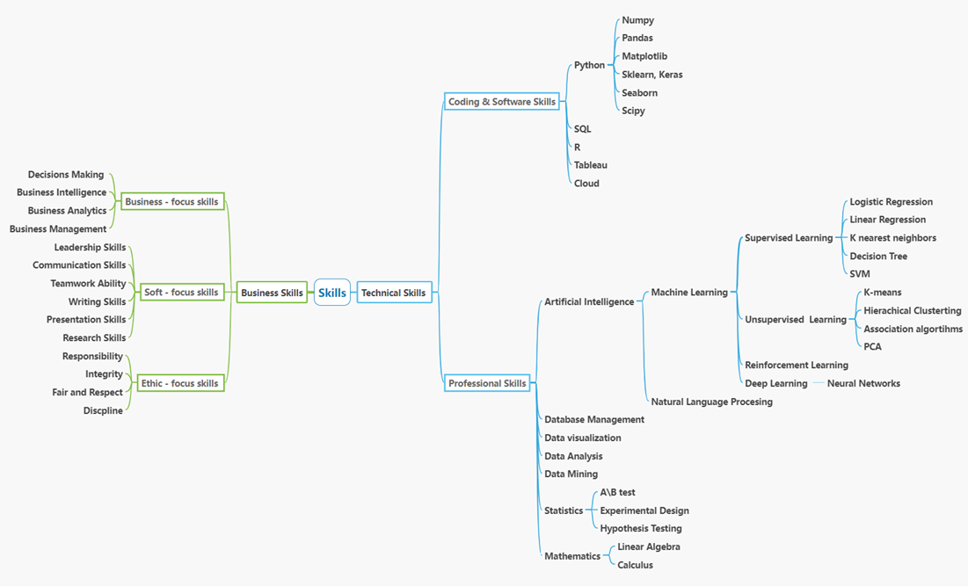
Notes:
This graph visualizes the whole program structure as well as the sequence of skills learned in this program. You can also see the three categories of skills.

Slide 14
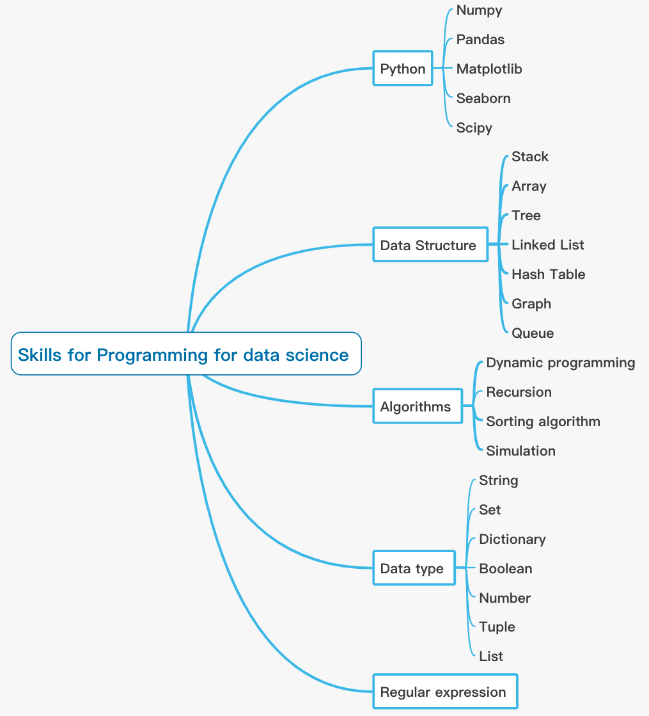
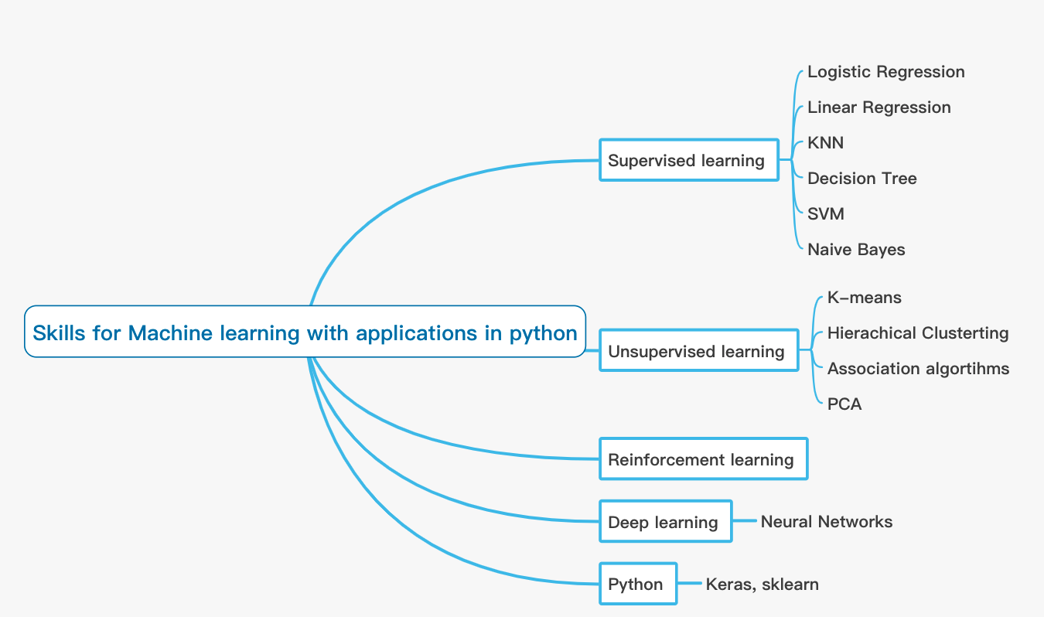
Course visualization
Notes:
We also have single course visualizations, for example, the graph on the left represents Course 2: Programming for Data Science and the one on the right represents Course 3: Machine Learning with Application in Python. We can see the large topics of the courses and also their smaller branches. More graphs on individual courses are attached in the report.

Slide 15
04
Recommender System Design
PART 04
Notes:
For part 4, we plan to design an app that includes a recommender system to personalize students’ study experience.

Slide 16
System Overview
A recommender system is designed to recommend related elective courses based on the content of each introductory and core course.
Students enroll in the program and register the DataPro App.
Step 2
Step 1
Step 3
Choose the career path that they are willing to take. e.g. data analyst, data scientist. Related introductory and core courses will show in the App.
Notes:
The system consists of 3 steps: the first step is that students can be registered in DataPro App once they enroll in the program; the second step is to choose career path. For each career path, a different combination of introductory and core courses will be required for students to study; the last step is to select the elective courses. The recommender system is designed to recommend elective courses based on core and introductory courses. Also, students can search keywords they are inetrested in to find their preferred elective courses.

Slide 17
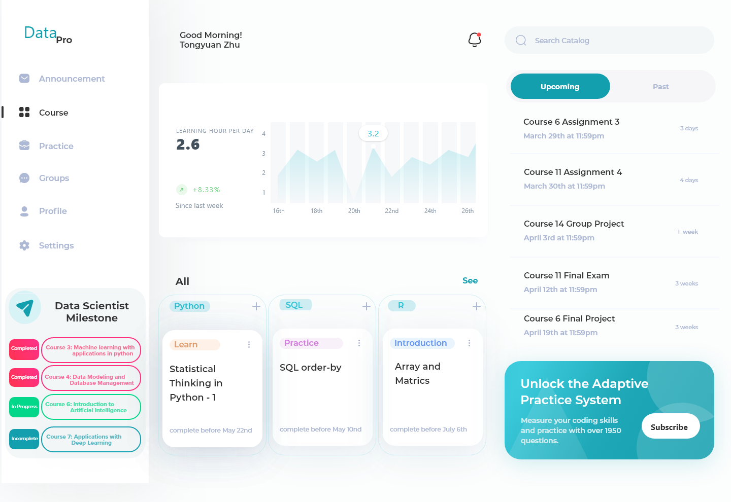
DataPro App Design (Main Page)
Notes:
This slide shows the main page design of DataPro App. It is used for showing the courses you are taking and daily study tracking.

Slide 18
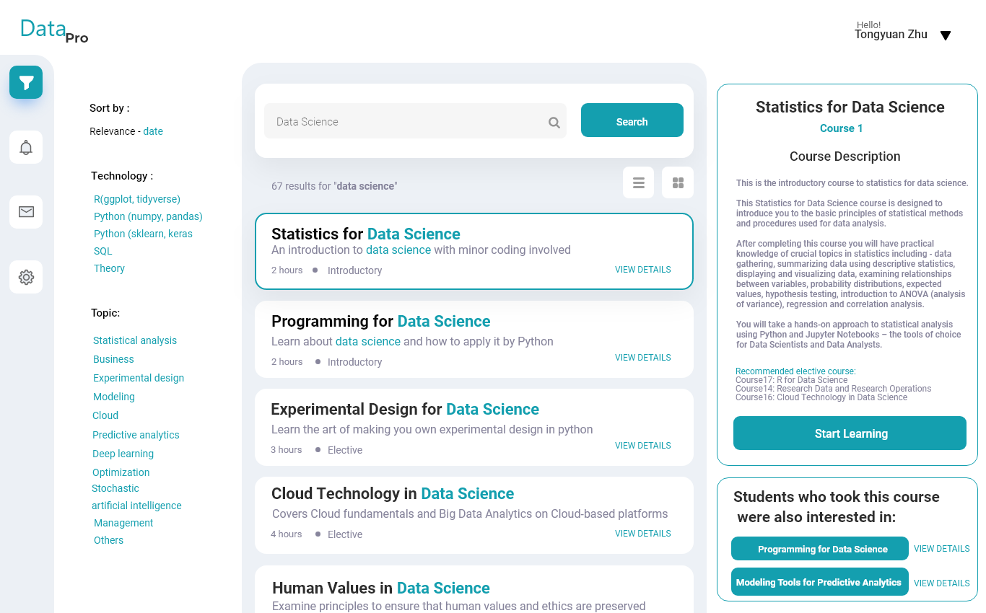
DataPro App Design (Search Page)
Notes:
This slide shows the search page of our app. In this page, students can see the courses they have selected. The right side of the interface shows course description and the recommened courses based on the algorithm designed in the recommender system. If students have their own preferences, the search bar can help you type in any keywords they are interested in and return the related elective courses.

Slide 19
Thank you!

